Slide 1


SDT 100 01
DECEMBER 2025
Is there a statistically significant gender pay gap among US developers with similar experience levels?
Presented By. Bara-Serene Mason
Brooke Martin
Kenzi Rullo
Yariana Figueroa Calimano

Slide 2

SDT 100 01
DECEMBER 2025
Why Does this Matter?
Ensuring fair business practices
Continuous evaluation to measure business practices
Full transparency with results to ensure ethical practices
Limiting discrimination through DEI policies

Slide 3

SDT 100 01
DECEMBER 2025
Data Overview:
TOTAL SAMPLE SIZE: 2393
SAMPLE OF MEN: 2217
SAMPLE OF WOMEN: 176
VARIABLES:
GENDER IDENTITY (MAN OR WOMAN)
SALARY ($30K - $500K)
EXPERIENCE (5-10 YEARS)
DEVELOPER JOB TITLE

Slide 4
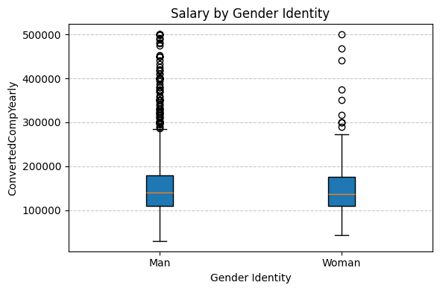
SDT 100 01
DECEMBER 2025
Visualization of Distribution:
Statistic | Men | Women
Median | 140K | 136K
Min | 30K | 44K
Max | 500K | 500K
IQR | 70K | 65K
25th Percentile | 110K | 110K
75th percentile | 180K | 175K

Slide 5
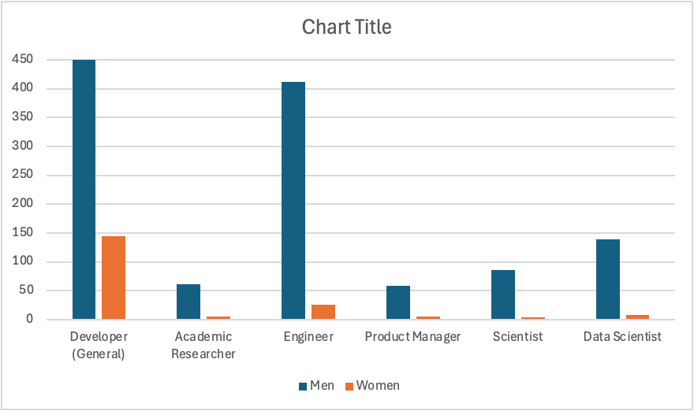
SDT 100 01
DECEMBER 2025
Visualization of Proportions:
DEVELOPERS (GENERAL)
145 WOMEN, 1885 MEN
MEN MAKE 2.86% MORE
ACADEMIC RESEARCHER:
6 WOMEN, 61 MEN
WOMEN MAKE 14.53% MORE
ENGINEERS:
26 WOMEN, 412 MEN
WOMEN MAKE 5.10% MORE
PRODUCT MANAGERS:
6 WOMEN, 59 MEN
WOMEN MAKE 22.5% MORE
SCIENTISTS:
4 WOMEN, 86 MEN
WOMEN MAKE 35.53% MORE
DATA SCIENTISTS:
8 WOMEN, 139 MEN
WOMEN MAKE 30.86% MORE

Slide 6
SDT 100 01
DECEMBER 2025
TWO SAMPLE TEST GENDER WAGE GAP:
95 % Confidence Level
Statistical Results:
t-statistic = 0.5
NULL HYPOTHESIS: THERE IS NO SIGNIFICANT GENDER WAGE GAP
ALTERNATIVE HYPOTHESIS: THERE IS A SIGNIFICANT GENDER WAGE GAP
p-value = 0.61
AT A 95% CONFIDENCE LEVEL, WE FAIL TO REJECT THE NULL HYPOTHESIS, THEREFORE THERE IS NOT A STATISTICALLY SIGNIFICANT GENDER WAGE GAP AMONGST US DEVELOPERS WITH 5-10 YEARS EXPERIENCE.
0.61 > 0.05

Slide 7
SDT 100 01
DECEMBER 2025
Statistical Results:
2 SAMPLE PROPORTION TEST OF GENDERS:
95 % Confidence Level
NULL HYPOTHESIS: THE PROPORTION OF WOMEN IN OUR SAMPLE IS EQUAL TO THE HYPOTHESIZED POPULATION PROPORTION OF 18.4%
ALTERNATIVE HYPOTHESIS: THE PROPORTION OF WOMEN IN OUR SAMPLE IS NOT THE SAME AS HYPOTHESIZED PROPORTION OF 18.4%
z-statistic = -20.7
p-value = 0.0
AT A 95% CONFIDENCE LEVEL, WE REJECT THE NULL HYPOTHESIS, THEREFORE THERE ARE SIGNIFICANTLY LESS WOMEN IN THE SAMPLE (7.35%) COMPARED TO THE POPULATION PROPORTION OF 18.4%.
0.0 < 0.05
THIS POPULATION PROPORTION WAS FOUND FROM DATA USA

Slide 8
SDT 100 01
DECEMBER 2025
Business Recommendations:
ATTEMPT TO INCORPORATE MORE DEVELOPERS WHO ARE WOMEN IN THE SURVEY TO PROPERLY REFLECT THE AMOUNT OF WOMEN IN THE DEVELOPER FIELD AS PER DATAUSA REPORTS (APPROXIMATELY 18%)
CONTINUE REGULAR ANALYSIS TO ENSURE THERE IS NOT A STATISTICALLY SIGNIFICANT PAY GAP BETWEEN GENDERS
ENSURING VETTING PROCESSES ARE EQUITABLE AND ALLOW FOR FAIR OPPORTUNITIES TO MALE AND FEMALE DEVELOPERS ALIKE, PUTTING FAIR JOB PRACTICES INTO ACTION BY ENSURING TRANSPARENCY AND ETHICAL PRACTICES
IMPLEMENT FAIR JOB PRACTICES AND INCORPORATING DEI INITIATIVES TO RETAIN EMPLOYEES WHO ARE WOMEN AS THEY ARE LARGELY UNDERREPRESENTED IN THE FIELD AND TO PROMOTE EQUAL PAY ACROSS GENDERS
FURTHER HYPOTHESES ON HOW YEARS OF EXPERIENCE AFFECTS PAY TO PROMOTE FAIR WAGES

Slide 9
SDT 100 01
DECEMBER 2025
Any Questions?

